Slide 1
Quick Intro
Hiram Fleitas
Senior Customer Engineer
Microsoft Data & AI
aka.ms/hiram

Slide 2
About Me
Machine Learning
Synapse Analytics
Power Platform
DevOps
aka.ms/hiram

Slide 3
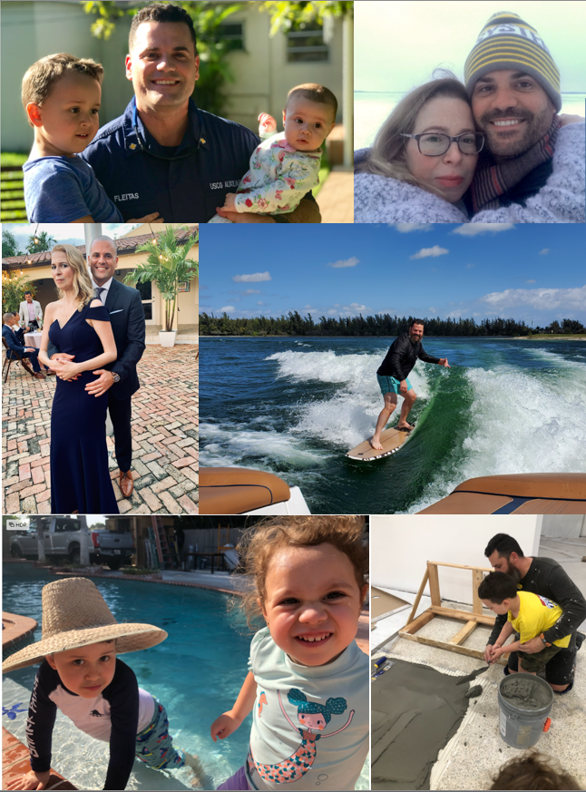
Hiram Fleitas
Who I Am:
Cuban and live in Miami since 93.
Wrote my first app at 13 and work with Computers since.
Recently, I’ve been laying tile at the home that I’m building for my family.
What I Do:
New Senior CE at Microsoft.
Worked on the SQL Big Data Cluster and ML Extension as an Early Adopter.
~25 years in Tech.
Analyze Me:
Father of 2, Ocean (5) and Skylar (3).
Resilient
Perseverance
Problem solver
Jar Opener
To Work With Me, You Should Know:
I speak English and Spanish.
You can reach me at any time.
I’m here to help.
The Last Word:
“Dad, you want to make something awesome with me. It shall be so crazy! LOL.”
“Believe in people.”
What I Like:
Construction
Breakfast with my kids
Watersports, wakesurf, wakeskate
Cuban coffee, hello!

Slide 4



















1995
1999
2000s
2017
2021

Slide 5
✔ Brand Awareness
✔ Fraud Detection - Customer Churn
✔ Ethics
✔ Sentiment
✔ QnA Chat Bots
✔ Forms
✔ Enterprise Capital Modeling - Financial Risk
✔ Length of Stay
✔ Object Detection

Slide 6
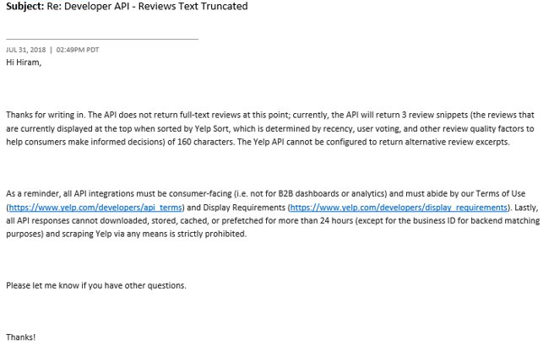
Learn more:
https://www.yelp.com/developers/api_terms
https://www.yelp.com/developers/display_requirements

Slide 7
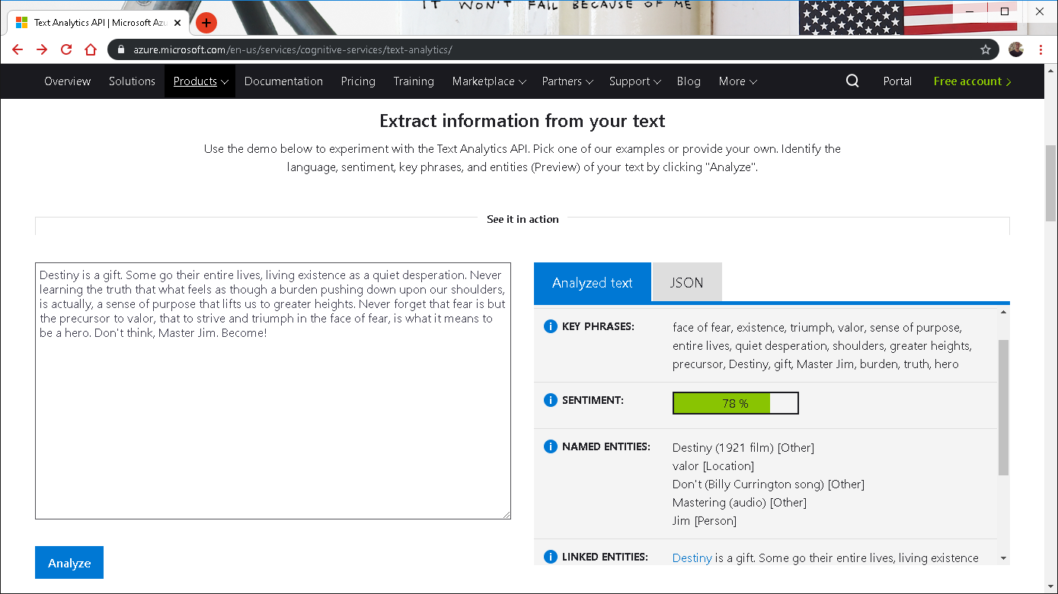

Notes:
https://www.netflix.com/title/80075820

Slide 8
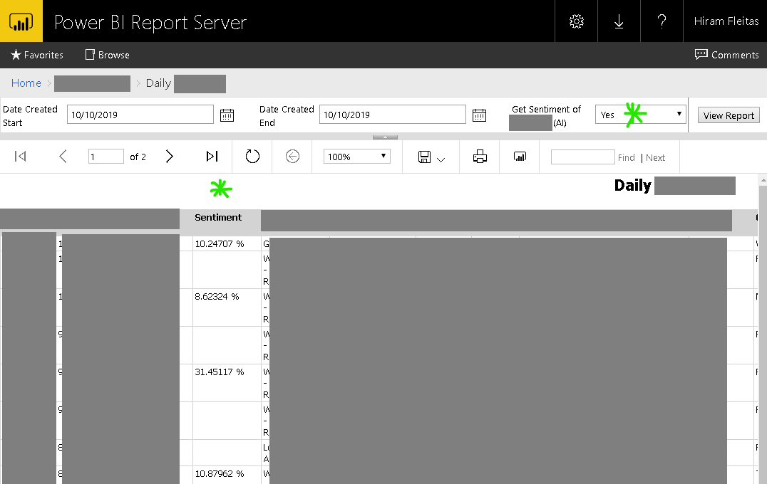
Learn more:
Hide Column based up Parameter Selected SSRS

Slide 9
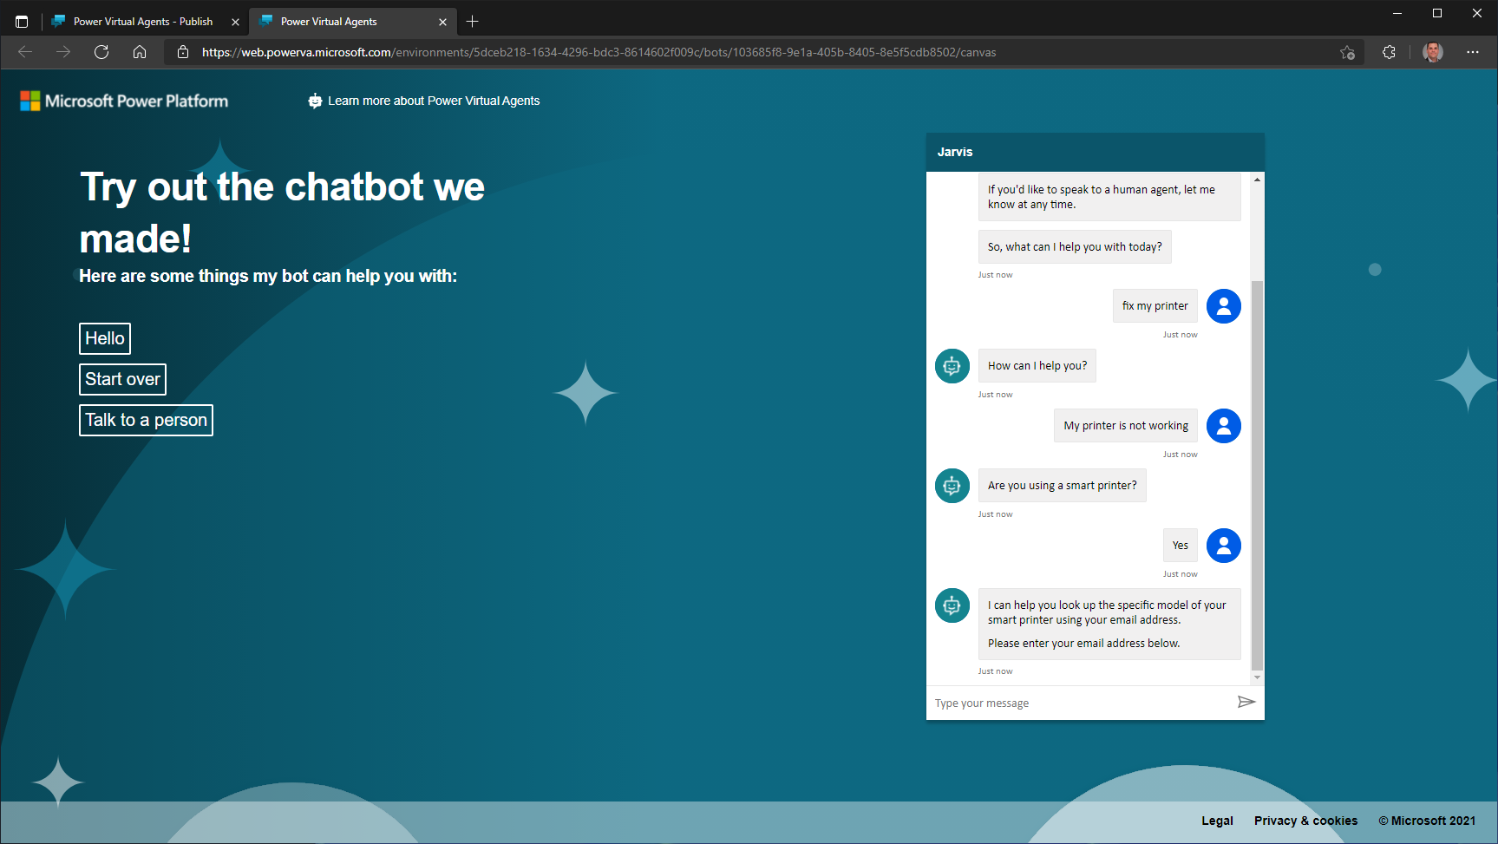
Notes:
https://www.netflix.com/title/80075820

Slide 10
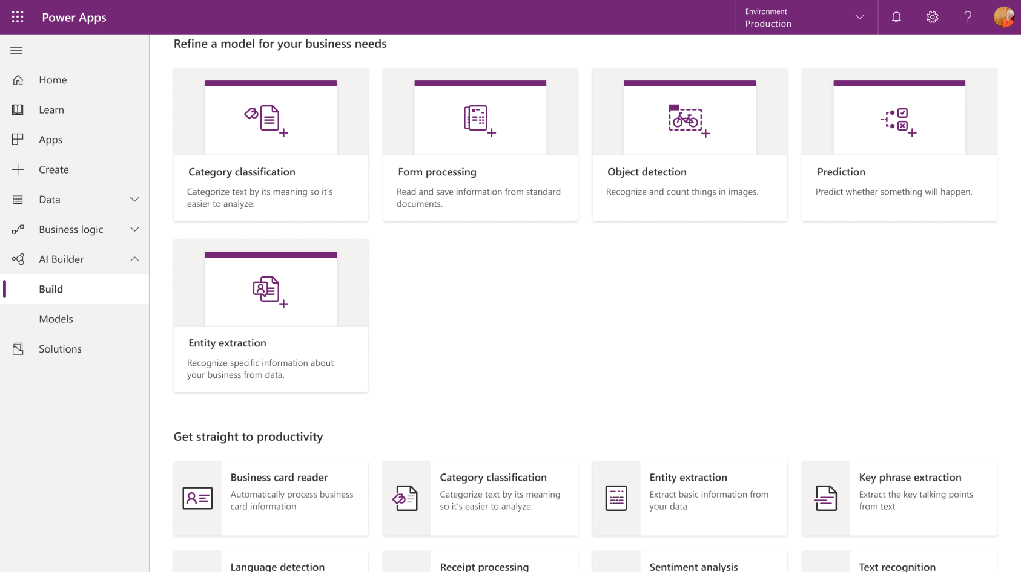

Slide 11
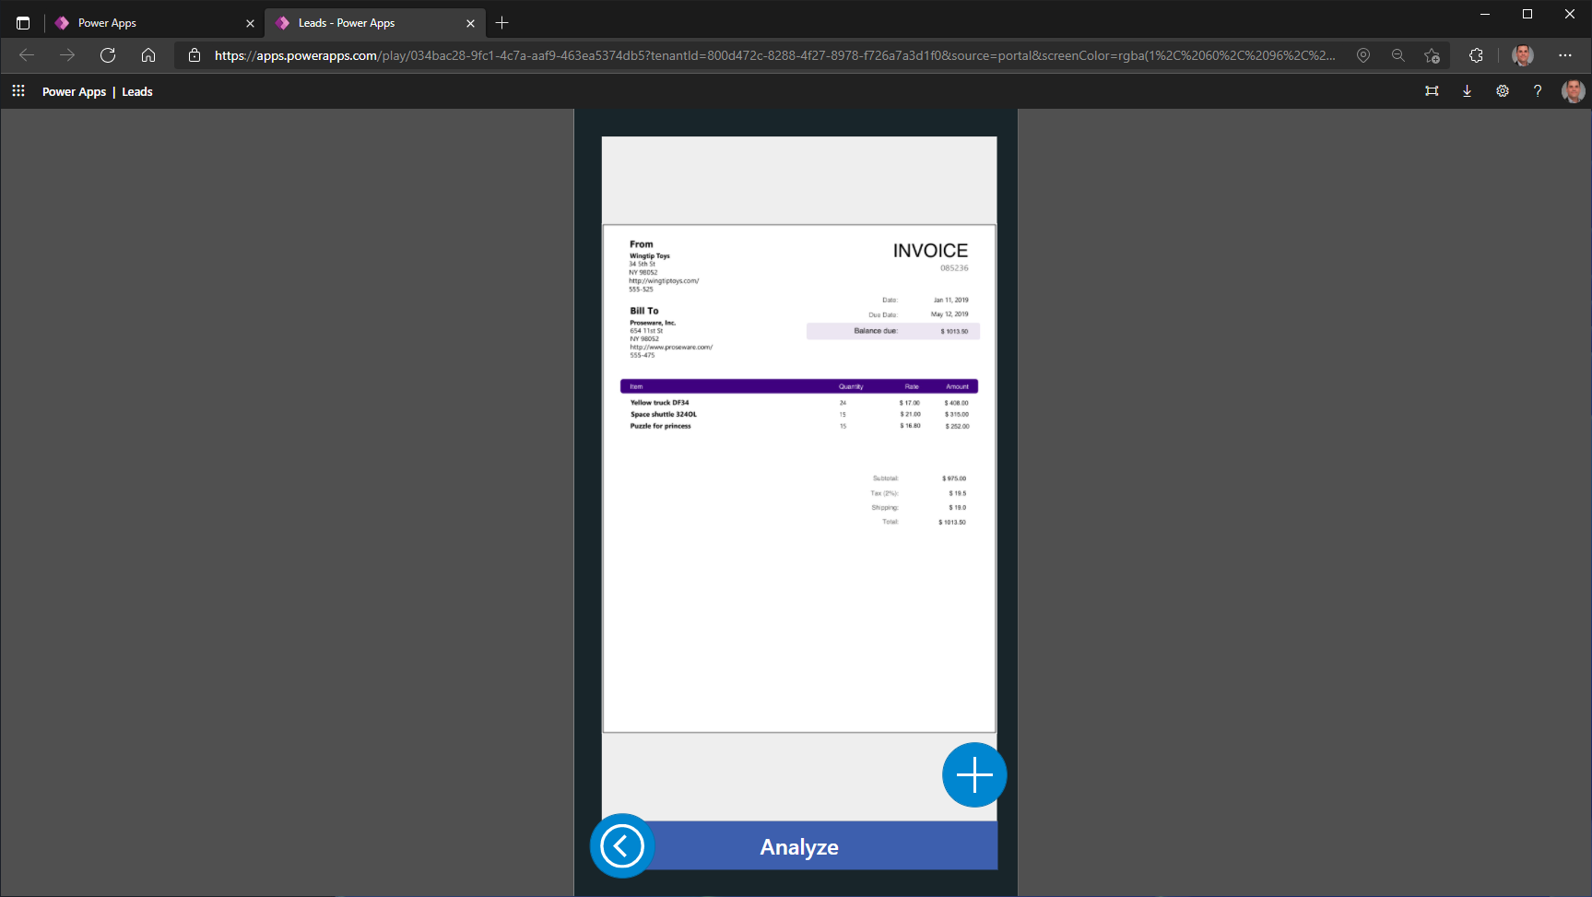

Slide 12
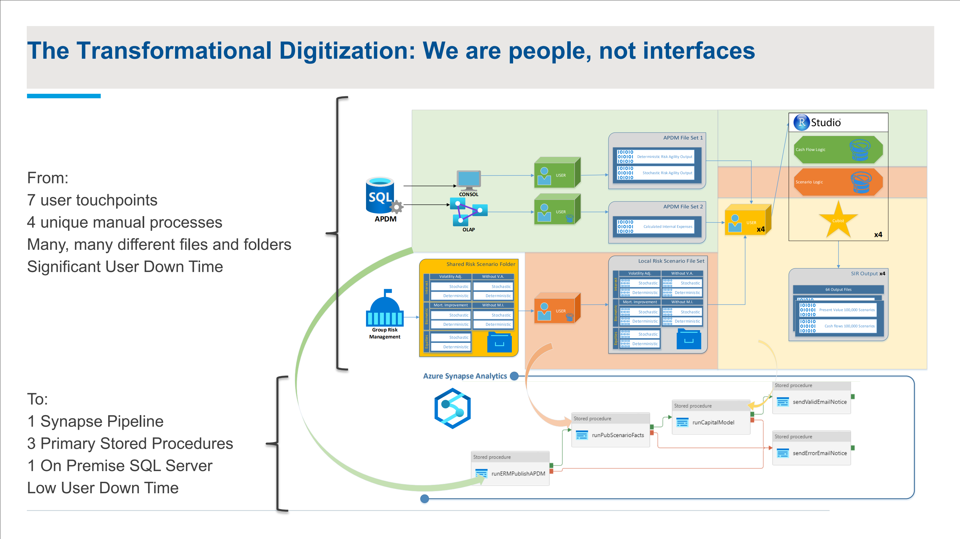
Notes:
https://www.netflix.com/title/80075820

Slide 13
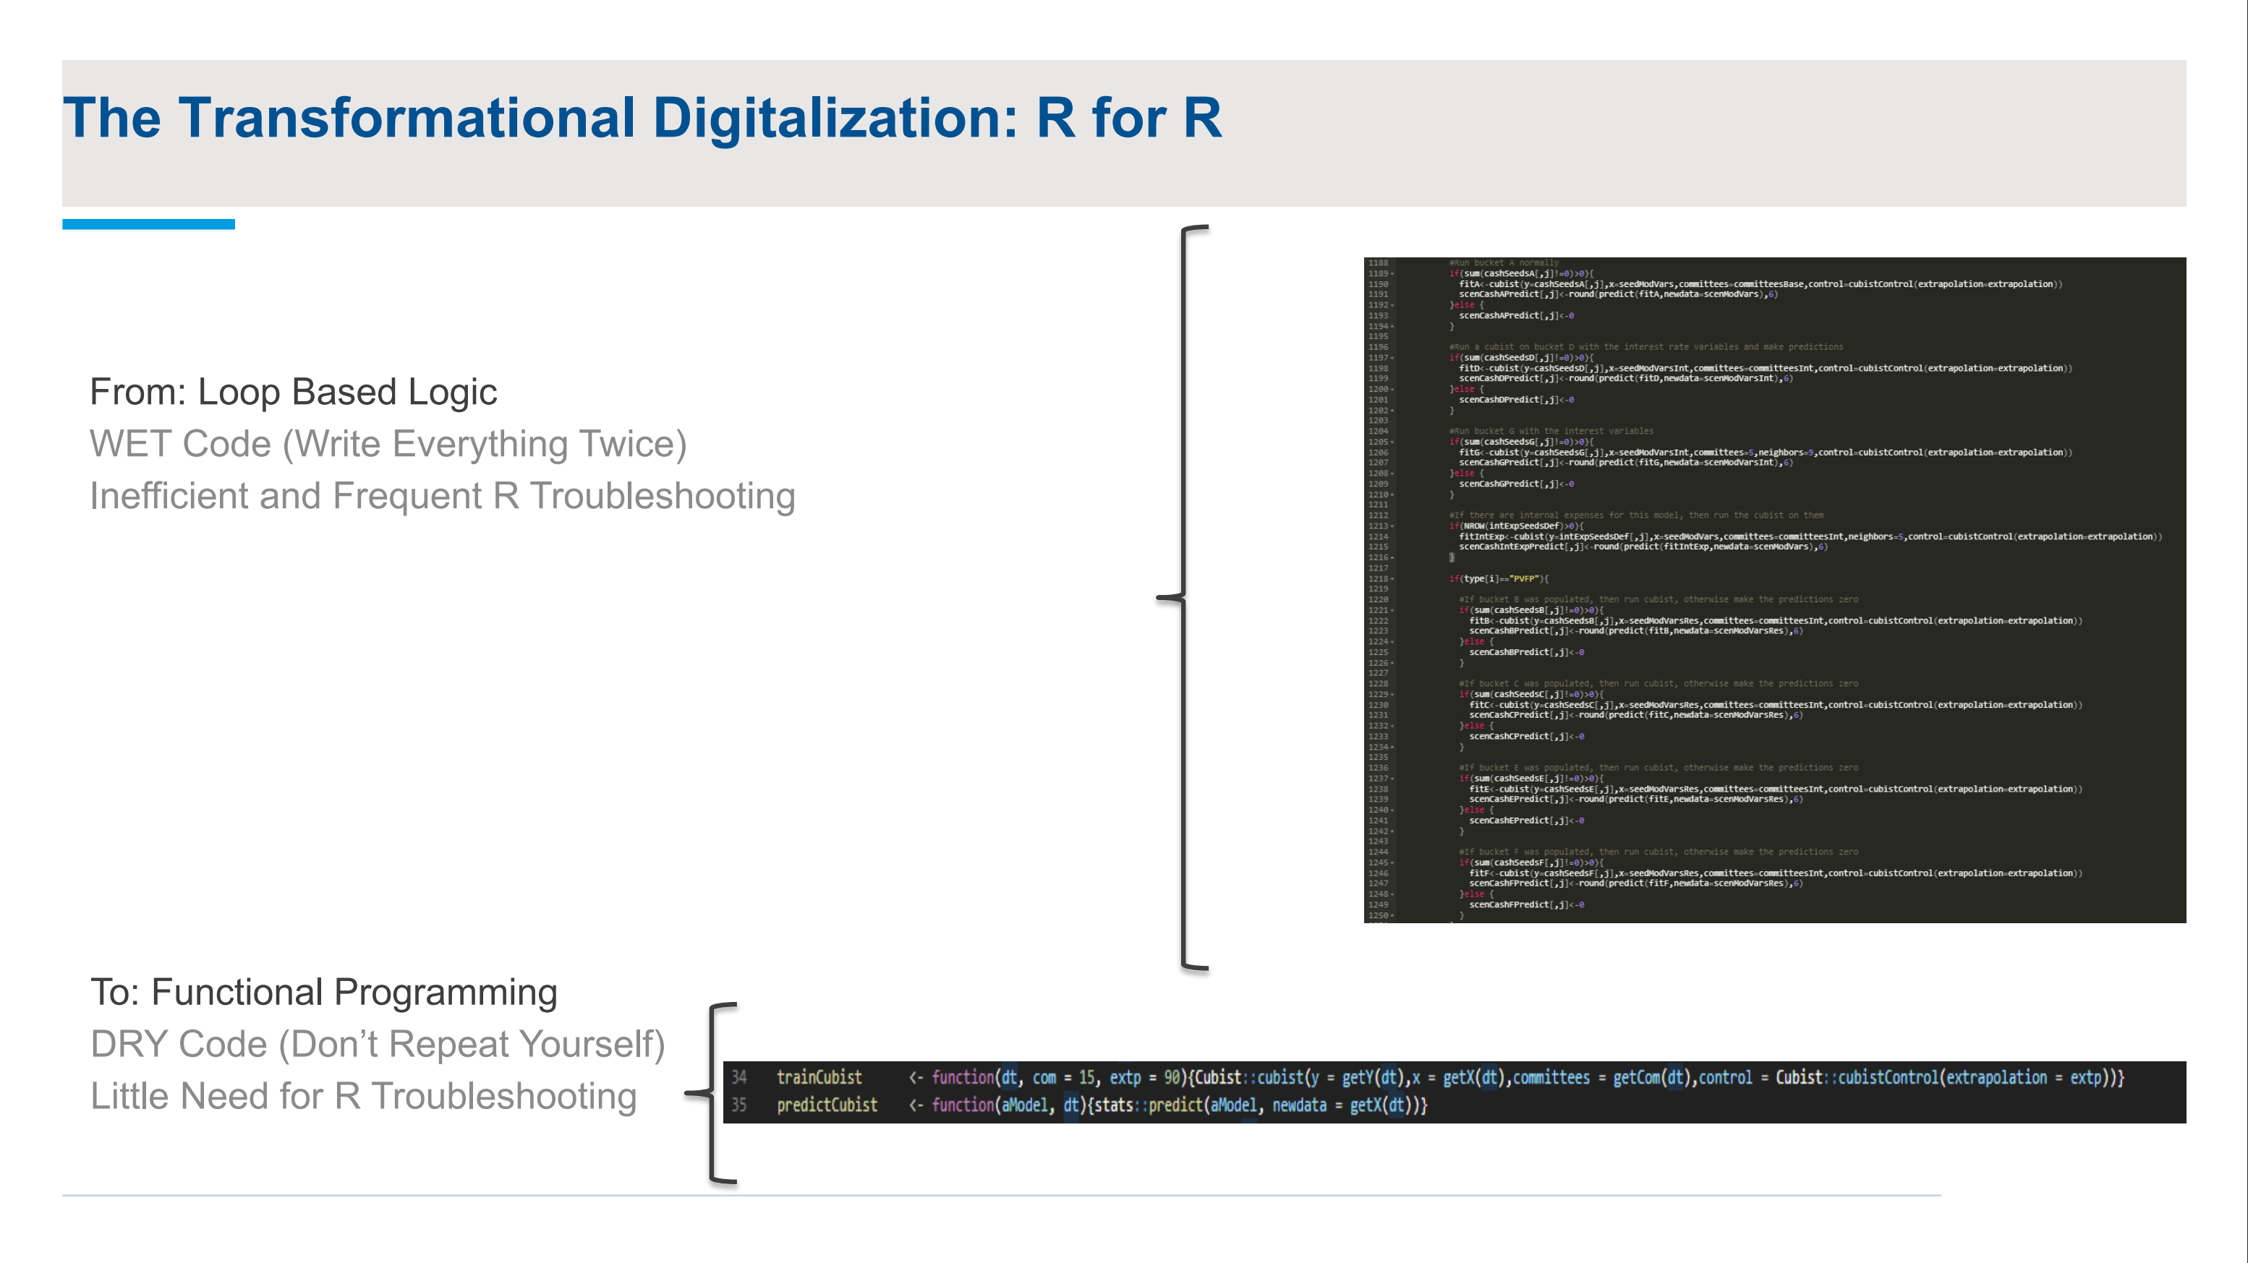
Notes:
https://www.netflix.com/title/80075820

Slide 14
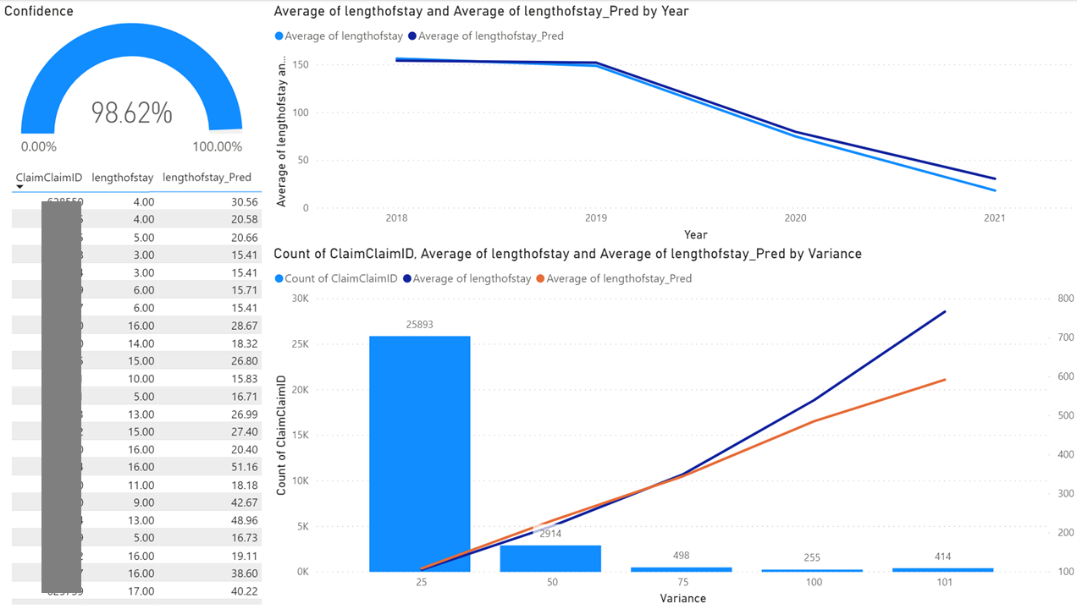

Slide 15
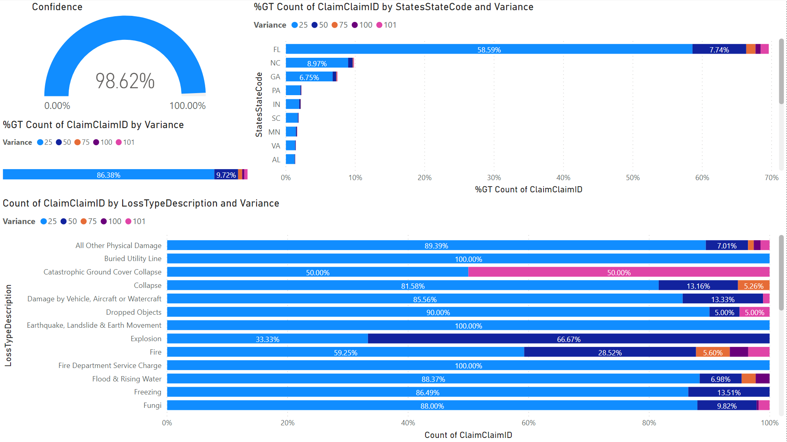

Slide 16
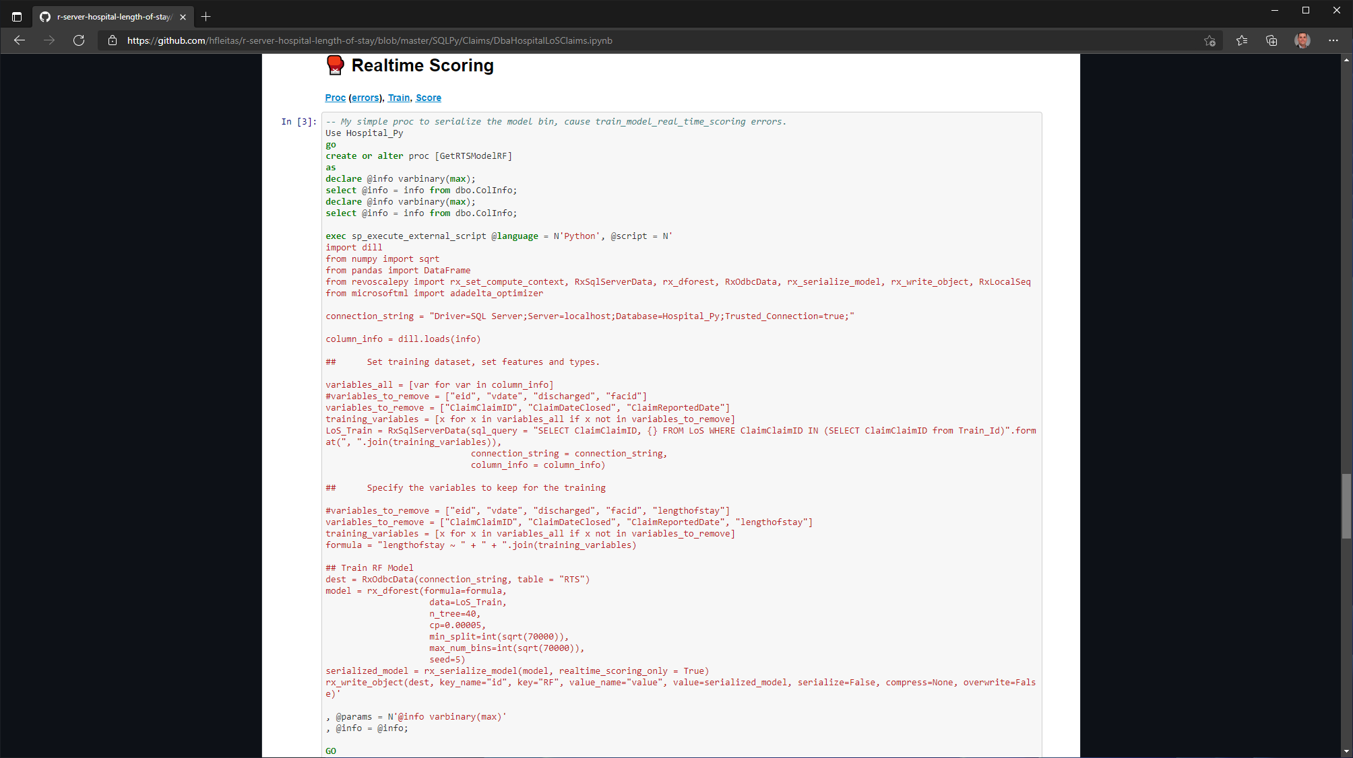


Slide 17
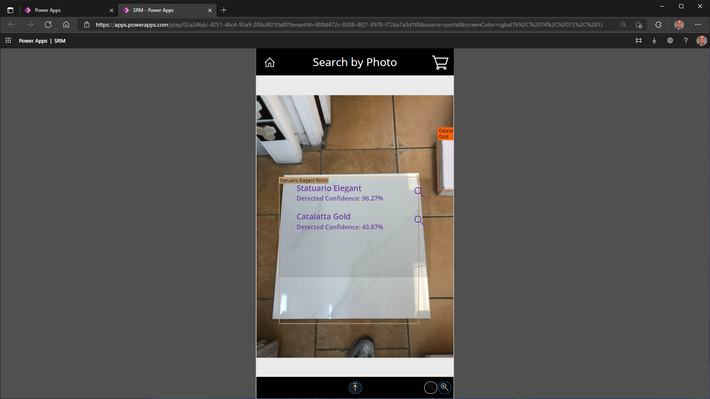

Slide 18












2017
2018
2019
2021
2021

Slide 19


Slide 20
Thank you
Hiram Fleitas
https://aka.ms/hiram

